Slide 1
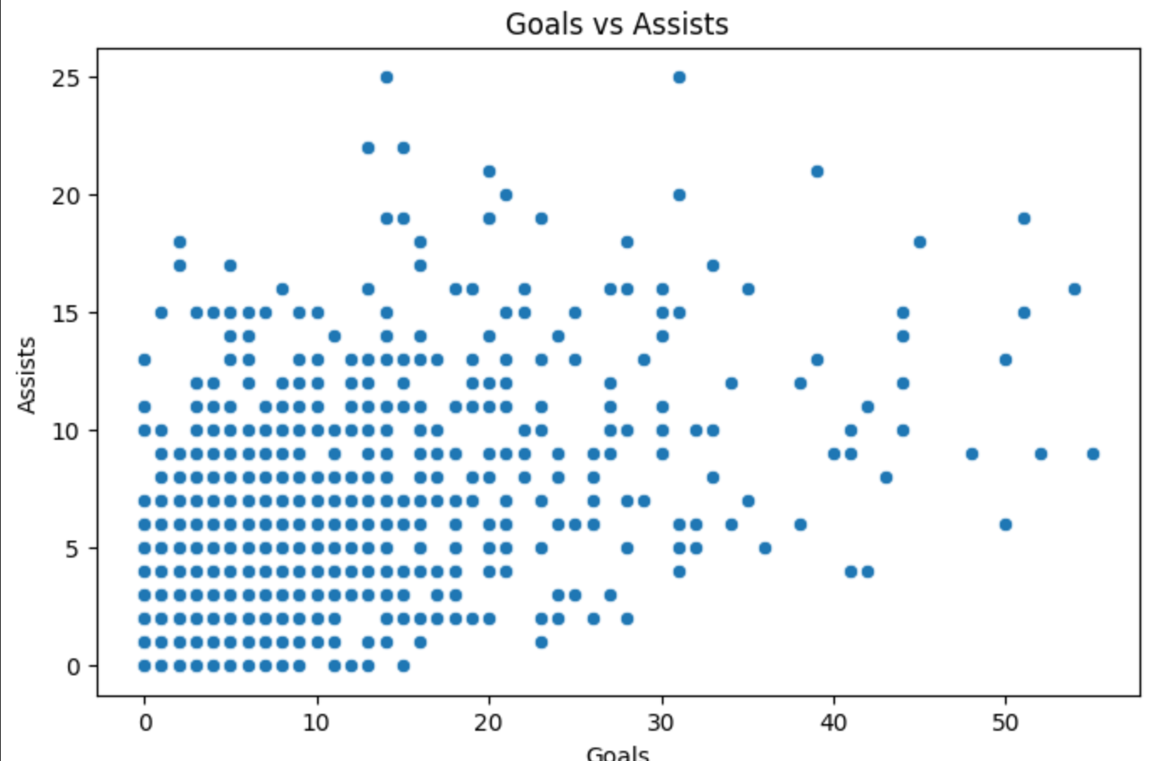
A
This connotes how the higher goals and assist is a rare occurrence, and most players will be on the lower end of both. So for instance, the players who for instance are around the area of ‘A’ are rare occurrences and are world class and have a special talent and scouts need to be looking for these outliers when looking for potential signings

Slide 2
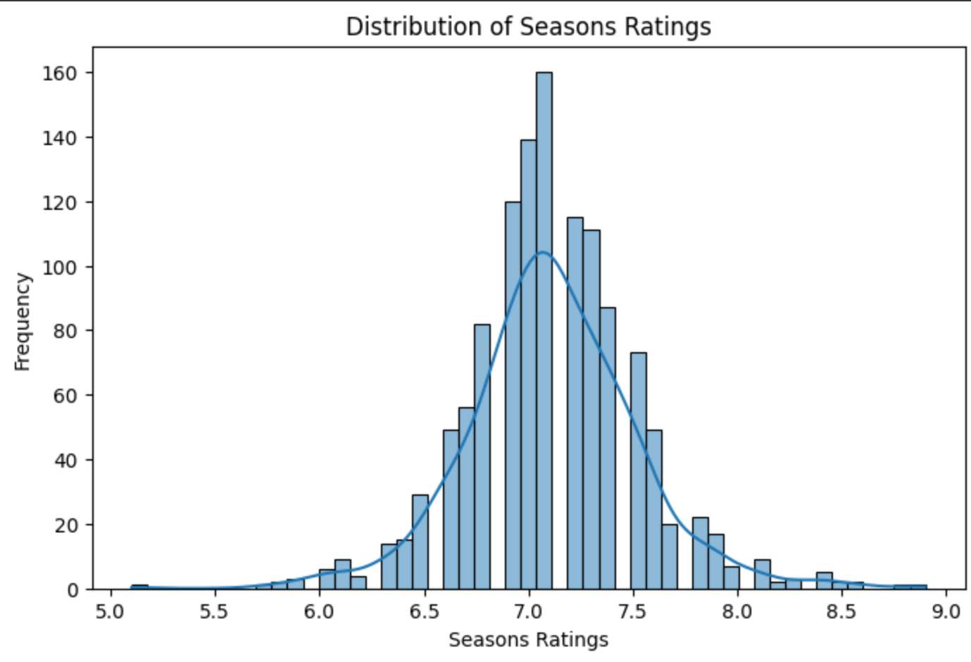
This Chart highlights the finding that these top players are most likely to come out with a rating around 7.0, this can be useful for understanding that when a player has an average rating of e.g. 8+ it highlight's the ability of the player and would allow for scouts to understand that if they’re looking for consistent and some of the best players then they would need to be looking at a season average of 8+.

Slide 3
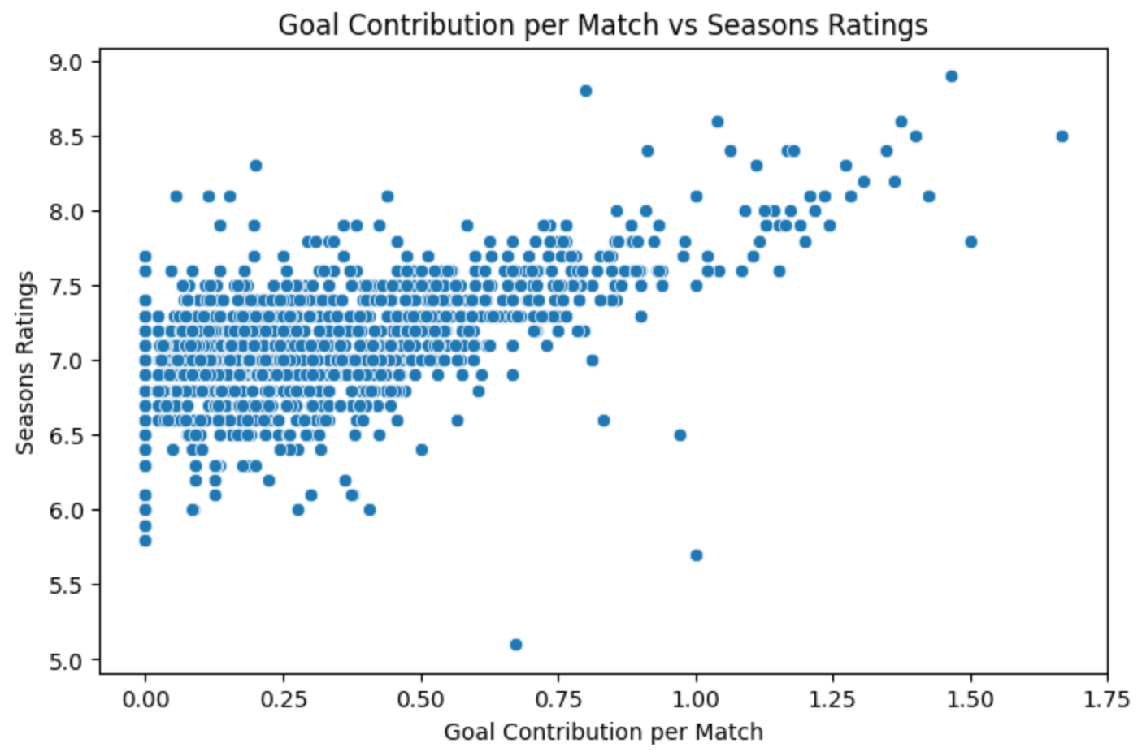
This graph highlights the correlation between goal contribution and season ratings, the outliers in this section will most likely come from defenders as their main goal isn’t to contribute to goals but as you can see the consensus is that the more goal contributions given the higher the season rating is going to come out as.

Slide 4
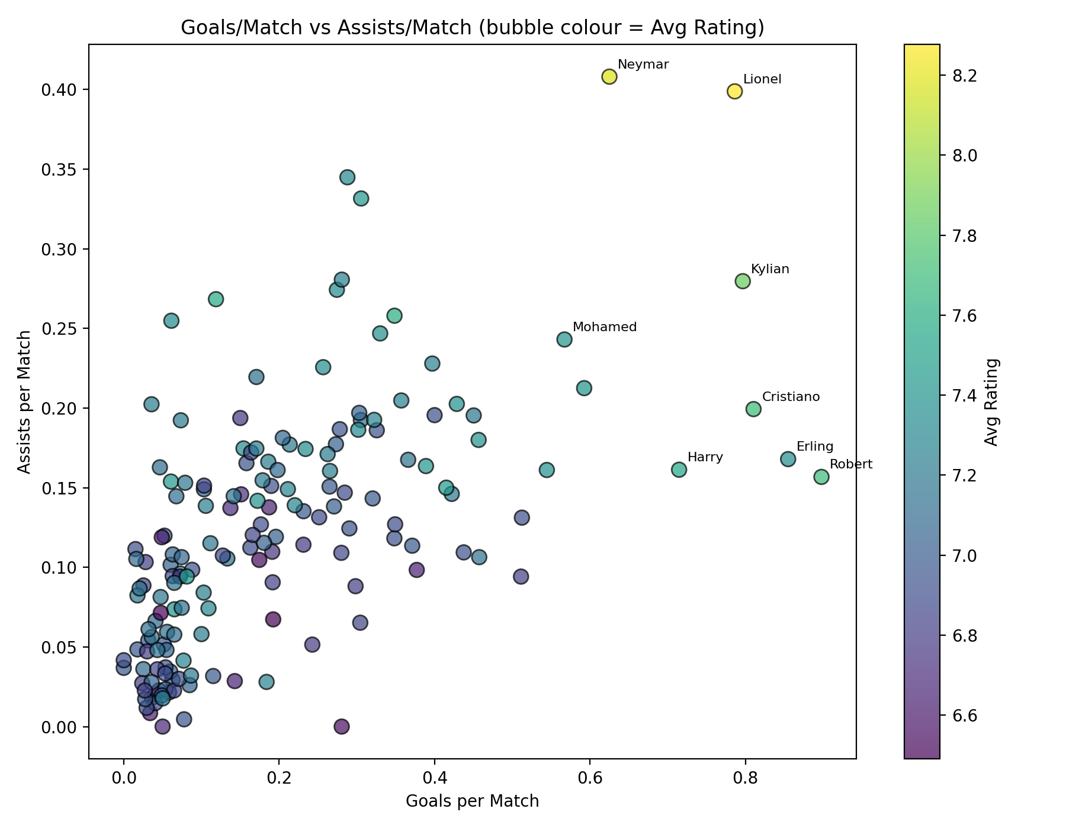
This Highlights the players who are providing the most contribution and are in the best form and most consistent – as you can also the colouring where the assists and goals per match is low is more purply highlighting how the average rating is also low – it also visually highlights the best players in the world at both scoring goals and assisting and then you have world class players such as Messi who are incredible at both.

Slide 5
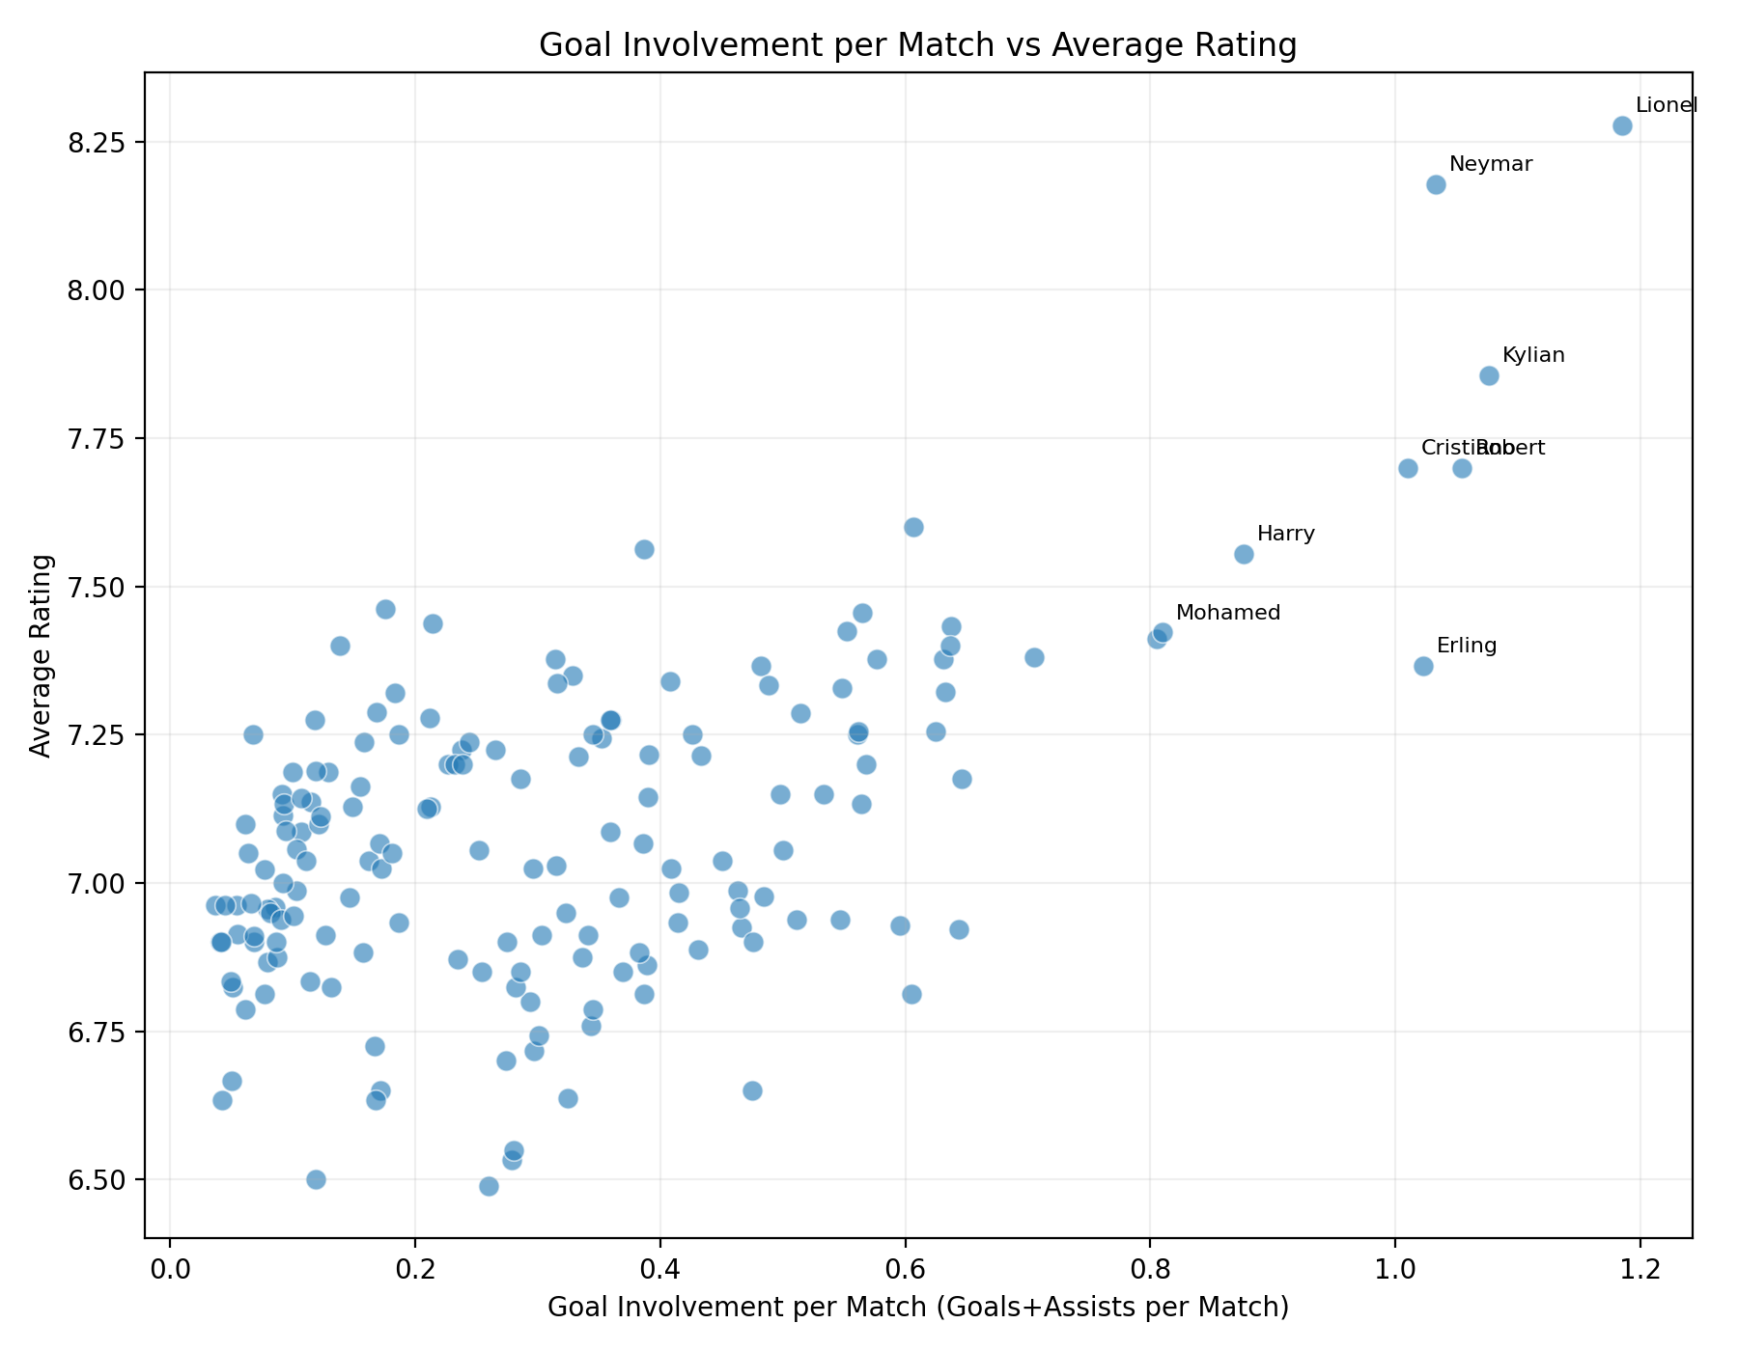
This is a similar graph to the last where there is a mix of both goals and assist here – where again you can see the same players who are top performers and also visually see again the correlation to goals and assists to average rating.

